Slide 1

Team Members: Kodanda Rama Yaswanth Kumar Ramadugu (KXR230001) Sai Prasanth Reddy (SXR220147)
Analysis of Branch Prediction on Different Benchmarks using gem5

Slide 2
Initial Set-Up
For this Project we have used Gem5 installed on the UTD Server.
Copied the Gem5 to our Local Directory using the command: “cp –rf /usr/local/gem5/home/011/k/kx/kxr230001/CA_Project_1”.
Compiled using the command: “scons build/X86/gem5.opt”.
After Compiling, we cloned the Benchmark Files to our local directory using the command provided: “git clone https://github.com/timberjack/Project1_SPEC.git”.

Slide 3
Branch Predictor
In a pipelined CPU, a branch predictor is an essential element that enhances performance.
It employs a technique to predict the result of a conditional operation in advance.
By using limited context and the current instruction's address, it anticipates the location of a branch instruction.
The predictor functions prior to the decoder pipeline phase, even with restricted historical data.
With time, its accuracy notably improves.
This technique significantly enhances accuracy over time.

Slide 4
Importance of Branch Predictor
Accurate branch prediction facilitates improved instruction throughput and overall performance gains.
It enables the execution of instructions from both predicted and sequential branch paths, thereby enhancing resource utilization through instruction-level parallelism.
Branch prediction, in line with speculative execution, ensures the processor is continuously engaged with work by executing instructions ahead of their actual requirement based on predicted outcomes.
Dynamic branch prediction involves the analysis and utilization of historical branch patterns, contributing to the creation of precise predictions.

Slide 5
Types of Predictors Used
There are Three different types of Branch Predictors used in this Project, they are
1. Local Branch Predictor
2. BiMode Branch Predictor
3. Tournament Branch Predictor

Slide 6
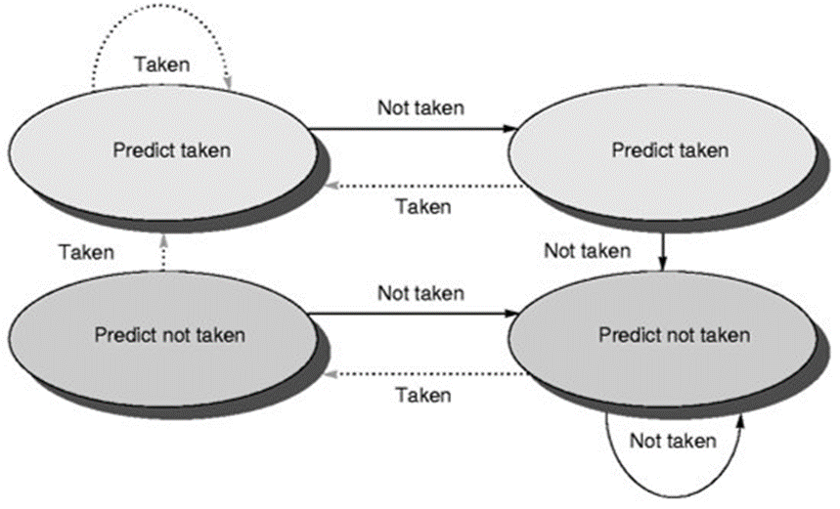
Local Predictor: Makes a prediction depending on the outcome of a branch for its last ten executions.
Stores a table of the history of branches at each location and uses this information to make predictions.
Local predictors work well when a program has repeating patterns of branches at specific locations.

Slide 7
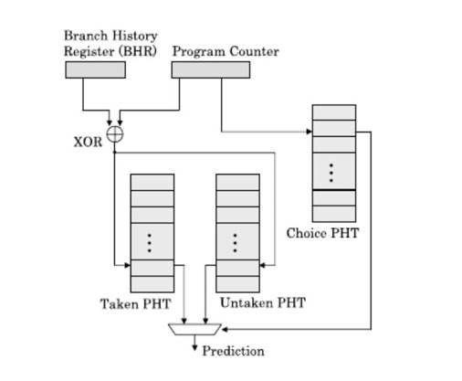
Bi-mode Predictor: It is a hybrid of local and global predictor. The bi-mode predictor uses a local predictor to predict the outcome of branches at specific locations in the program and a global predictor to predict branches that do not have a history at the current location.
The global predictor uses a history buffer to store the history of recent branches in the program and uses this information to make predictions.
The bi-mode predictor selects either the local or global predictor based on the history of recent branches at the current location in the program.

Slide 8
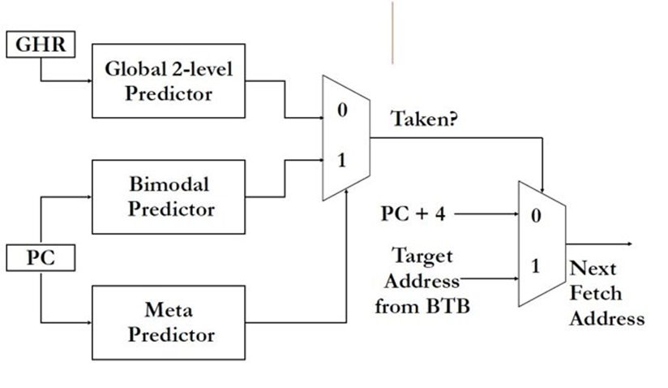
Tournament Predictor: It improves the accuracy of predictions by using a combination of two or more other branch predictors.
Uses a meta-predictor to determine which of the branch predictors should be used for each branch instruction. The meta-predictor compares the accuracy of the predictions made by the different predictors and selects the one with the highest accuracy for each branch.
This approach can provide higher prediction accuracy than any individual predictor alone.

Slide 9
Project Requirements and Specifications
Objective
To Simulate different branch predictors over different benchmarks and observing their behavior hierarchy in X86 architecture on Gem5 simulator .
Tools Used
Gem5 simulator on the university server
MobaXterm: For remote SSH extension to access Gem5 over university server
Benchmarks: (1) 456.hmmer (2) 458.sjeng
Branch Predictors: (1) LocalBP( ) (2) BiModeBP( ) (3) TournamentBP ( )
Shell Script: Created a shell script project2.sh for the project

Slide 10
Tradeoffs-
Criteria | Bimodal Branch Predictor | Local 2-bit Branch Predictor | Tournament Branch Predictor
Accuracy | Least accurate | More accuracy than Bimodal | Most accurate
Hardware over Tradeoffs-head | Least requirement of hardware resources | More requirement of hardware resources than Bimodal | Most requirement of hardware resources
Implementation Complexity | Simplest | More complex | Most complex

Slide 11
Deliverables
Changes made to source files.
Observing the changes made.
Generating the BTBMissPct and Branch Mispred Percent for all Benchmarks
Varying the sizes of predictor and calculating the same for TournamentBP
Graphs of each benchamark for each Branch Predictor
Observations from the graphs.

Slide 12
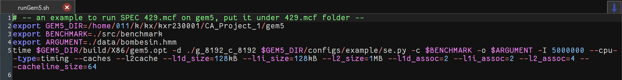
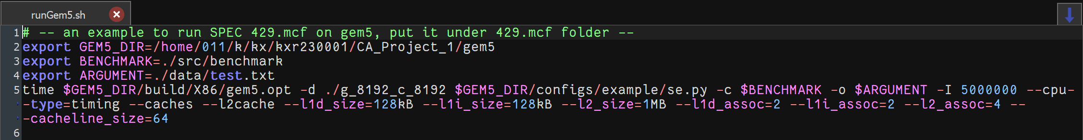
Changes in Gem5
We made the following changes to the respective “runGem5.sh” files for the Benchmarks 456.hmmer and 458.sjeng.
Change the Argument path in every benchmark.
Change the path of the gem5 directory.

Slide 13
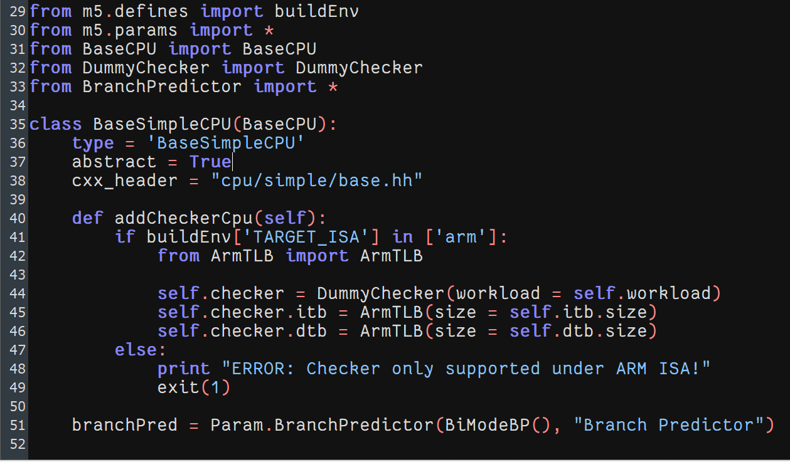
In the Gem5 folder, to change the branch predictor type
Go to cd gem5/src/cpu/simple .
Edit the file named “BaseSimpleCPU.py” and at the bottom we find the line: branchPred = Param.BranchPredictor (NULL, “Branch Predictor”)
In place of null we put the branch predictor types given: 1. LocalBP 2. BimodeBP 3. TournamentBP.
After changing each BP, delete all the files gem5/build/X86 first and then use the scons (% scons build/X86/gem5.opt) command to recompile in order to reflect the changes.

Slide 14
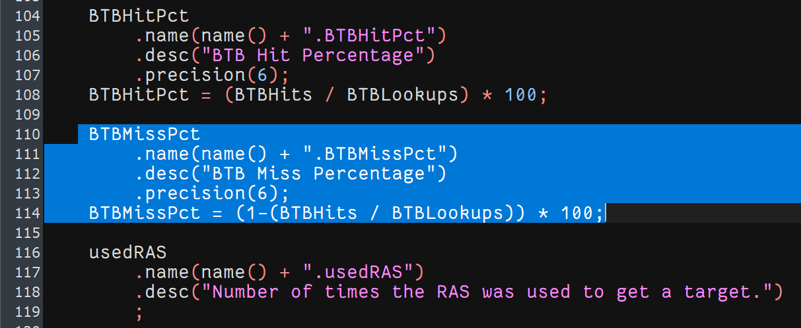
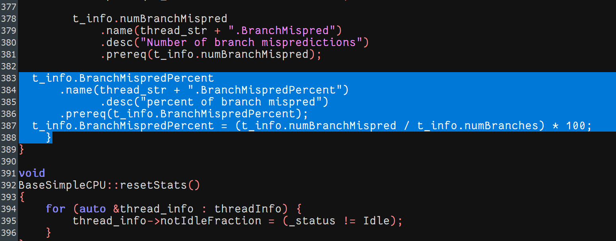
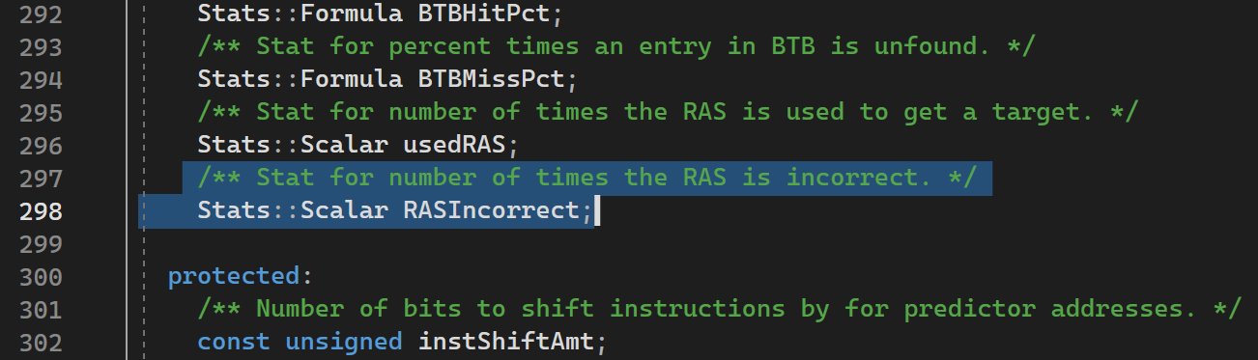
Changes to source files
Changes in bpred_unit.cc file for adding the definition of BTBMissPct
Changes in base.cc file for definition of BranchMispredPercent
Changes in exec_context.hh file

Slide 15
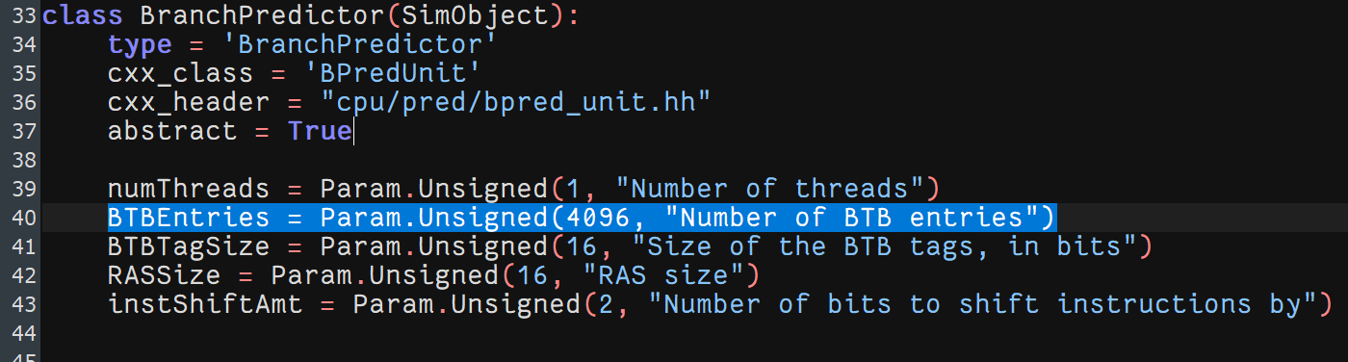
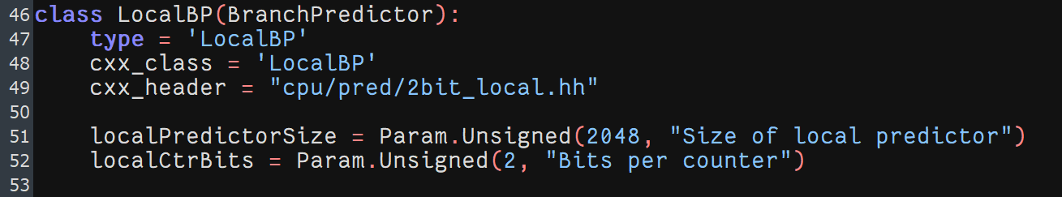
We make following changes in sizes of the predictor in gem5 in file: gem5/src/cpu/pred/Branchpredictor.py
In class BranchPredictor : Number of BTB entries is changed .
In class LocalBP: Size of local predictor is changed

Slide 16
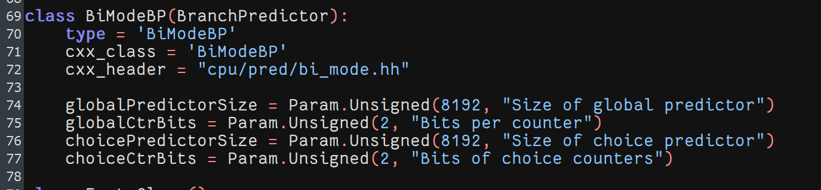
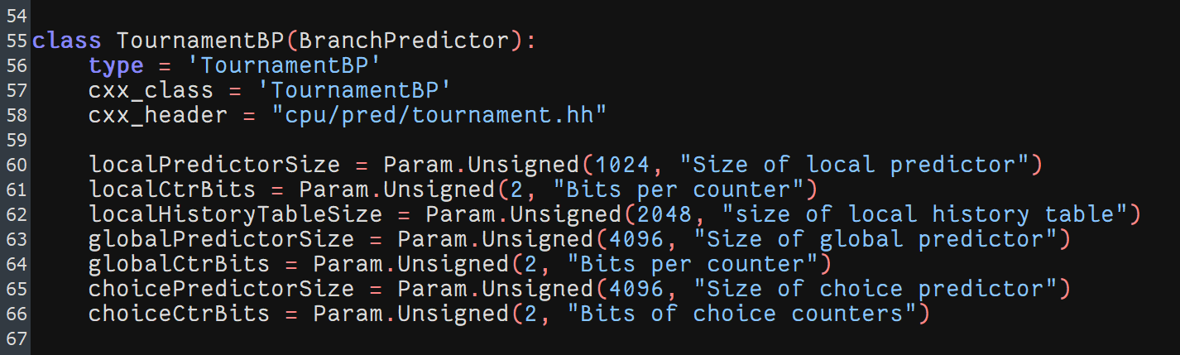
In class BiModeBP: globalPredictorSize and choicePredictorSize are changed
In class TournamentBP: localPredictorSize, globalPredictorSize and choicePredictorSize are changed

Slide 17
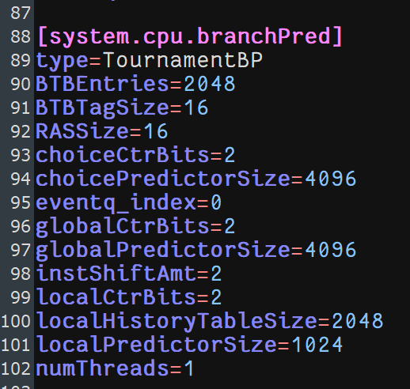
Outputs to be observed after compiling
Following the adjustments, we execute the script across all benchmarks, separately evaluating the performance of each of the three Branch Predictors and comparing the results.
Subsequently, we inspect the m5out/config.ini file for each benchmark to confirm that the system.cpu.pred type corresponds to the updated Branch Predictor.

Slide 18
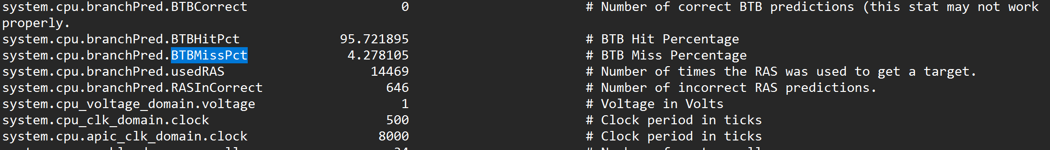
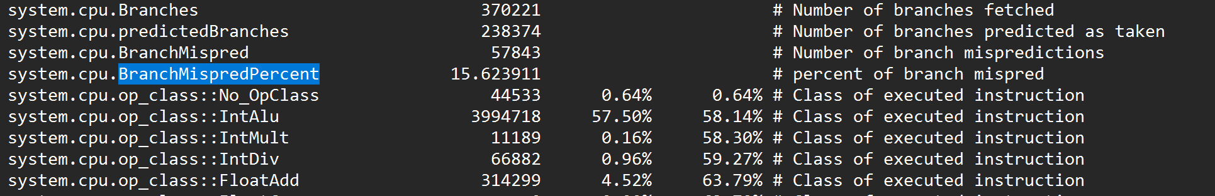
We can find the results in our TournamentBP stats.txt file of every benchmark

Slide 19
Show the results obtained when using different branch predictors and compare all 3 of them for the 456.hmmer & 458.sjeng benchmarks

Slide 20

456.hmmer
456.hmmer
Branch Prediction | BTB Miss Pct | BTB MissPredPercent | Weightage Average
Local BP | 7.963044 | 19.547514 | 0.006424
BiMode BP | 7.681322 | 19.519962 | 0.006669
Tournament BP | 3.686218 | 16.964462 | 0.015991

Slide 21
458.sjeng
458.sjeng
Branch Prediction | BTB Miss Pct | BTB MissPredPercent | Weightage Average
Local BP | 0.264503 | 1.426447 | 2.650414
BiMode BP | 0.263558 | 1.425540 | 2.661610
Tournament BP | 0.014303 | 1.428261 | 48.951419

Slide 22
Insights
The branch misprediction percentage indicates the frequency of incorrect predictions by the branch predictor.
The BTB miss percentage shows how often the Branch Target Buffer fails to find the branch target.
The weighted average is a combined metric that offers an overall evaluation of the branch predictor's performance.
In comparison to the Local branch predictor, the Tournament and BiMode branch predictors have higher weighted averages, suggesting superior overall performance based on the applied weighting scheme.
Among the predictors, the Tournament branch predictor exhibits the lowest branch misprediction percentage, followed by the BiMode predictor, while the Local branch predictor shows the highest misprediction percentage.
The Tournament predictor also demonstrates the lowest BTB miss percentage, indicating more effective utilization of the Branch Target Buffer.

Slide 23
Report how varying the size of the predictor affects the BTB Miss Pct and Branch Miss Prediction Pct for the 456.hmmer & 458.sjeng benchmarks.

Slide 24
456.hmmer & 458.sjeng (Local BP)
BTB Miss Pct
BTB Entries | Sizes | 456.hmmer | 458.sjeng
2048 | l_1024 | 0.038656 | 0.305865
2048 | l_2048 | 7.963044 | 0.264503
4096 | l_1024 | 9.726104 | 0.298344
4096 | l_2048 | 7.681322 | 0.263558
BTB MissPredPercent
BTB Entries | Sizes | 456.hmmer | 458.sjeng
2048 | l_1024 | 19.560479 | 1.421913
2048 | l_2048 | 19.547514 | 1.426447
4096 | l_1024 | 19.530767 | 1.417379
4096 | l_2048 | 19.519962 | 1.425540

Slide 25
456.hmmer Miss Pct (BiMode BP)
BTB Miss Pct
BTB Entries | Sizes | 456.hmmer
2048 | g_2048_c_2048 | 3.686218
2048 | g_2048_c_4096 | 3.601698
2048 | g_2048_c_8192 | 3.676413
2048 | g_4096_c_2048 | 1.928897
2048 | g_4096_c_4096 | 2.076089
2048 | g_4096_c_8192 | 2.025089
2048 | g_8192_c_2048 | 1.270800
2048 | g_8192_c_4096 | 1.342716
2048 | g_8192_c_8192 | 1.193160
2048 | l_1024 | 9.726104
2048 | l_2048 | 7.681322
BTB Miss Pct
BTB Entries | Sizes | 456.Hmmer
4096 | g_2048_c_2048 | 3.611066
4096 | g_2048_c_4096 | 3.521427
4096 | g_2048_c_8192 | 3.597299
4096 | g_4096_c_2048 | 1.856092
4096 | g_4096_c_4096 | 2.005599
4096 | g_4096_c_8192 | 1.953633
4096 | g_8192_c_2048 | 1.227536
4096 | g_8192_c_4096 | 1.303096
4096 | g_8192_c_8192 | 1.153925
4096 | l_1024 | 9.726189
4096 | l_2048 | 7.681396

Slide 26
456.hmmer Miss Predict Pct (BiMode BP)
BTB Miss Predict Pct
BTB Entries | Sizes | 456.hmmer
2048 | g_2048_c_2048 | 16.964462
2048 | g_2048_c_4096 | 16.981209
2048 | g_2048_c_8192 | 16.997145
2048 | g_4096_c_2048 | 17.170285
2048 | g_4096_c_4096 | 17.199457
2048 | g_4096_c_8192 | 17.230789
2048 | g_8192_c_2048 | 17.268875
2048 | g_8192_c_4096 | 17.292914
2048 | g_8192_c_8192 | 17.311282
2048 | l_1024 | 19.530767
2048 | l_2048 | 19.519962
BTB Miss Pct
BTB Entries | Sizes | 456.hmmer
4096 | g_2048_c_2048 | 0.014303
4096 | g_2048_c_4096 | 0.014303
4096 | g_2048_c_8192 | 0.017164
4096 | g_4096_c_2048 | 0.006679
4096 | g_4096_c_4096 | 0.006679
4096 | g_4096_c_8192 | 0.005725
4096 | g_8192_c_2048 | 0.000955
4096 | g_8192_c_4096 | 0.000955
4096 | g_8192_c_8192 | 0
4096 | l_1024 | 0.035076
4096 | l_2048 | 0.031959

Slide 27
458.sjeng Miss Pct (BiMode BP)
BTB Miss Pct
BTB Entries | Sizes | 458.sjeng
2048 | g_2048_c_2048 | 0.014303
2048 | g_2048_c_4096 | 0.014303
2048 | g_2048_c_8192 | 0.017164
2048 | g_4096_c_2048 | 0.006679
2048 | g_4096_c_4096 | 0.006679
2048 | g_4096_c_8192 | 0.005725
2048 | g_8192_c_2048 | 0.000955
2048 | g_8192_c_4096 | 0.000955
2048 | g_8192_c_8192 | 0.000000
2048 | l_1024 | 0.298344
2048 | l_2048 | 0.263558
BTB Miss Pct
BTB Entries | Sizes | 458.sjeng
4096 | g_2048_c_2048 | 0.014303
4096 | g_2048_c_4096 | 0.014303
4096 | g_2048_c_8192 | 0.017164
4096 | g_4096_c_2048 | 0.006679
4096 | g_4096_c_4096 | 0.006679
4096 | g_4096_c_8192 | 0.005725
4096 | g_8192_c_2048 | 0.000955
4096 | g_8192_c_4096 | 0.000955
4096 | g_8192_c_8192 | 0
4096 | l_1024 | 0.298431
4096 | l_2048 | 0.263645

Slide 28
458.sjeng Miss Predict Pct (BiMode BP)
BTB Miss Predict Pct
BTB Entries | Sizes | 458.sjeng
2048 | g_2048_c_2048 | 1.428261
2048 | g_2048_c_4096 | 1.428261
2048 | g_2048_c_8192 | 1.429167
2048 | g_4096_c_2048 | 1.474509
2048 | g_4096_c_4096 | 1.474509
2048 | g_4096_c_8192 | 1.474509
2048 | g_8192_c_2048 | 1.528012
2048 | g_8192_c_4096 | 1.528919
2048 | g_8192_c_8192 | 1.528919
2048 | l_1024 | 1.417379
2048 | l_2048 | 1.425540
BTB Miss Predict Pct
BTB Entries | Sizes | 458.sjeng
4096 | g_2048_c_2048 | 0.014303
4096 | g_2048_c_4096 | 0.014303
4096 | g_2048_c_8192 | 0.017164
4096 | g_4096_c_2048 | 0.006679
4096 | g_4096_c_4096 | 0.006679
4096 | g_4096_c_8192 | 0.005725
4096 | g_8192_c_2048 | 0.000955
4096 | g_8192_c_4096 | 0.000955
4096 | g_8192_c_8192 | 0.000000
4096 | l_1024 | 0.007349
4096 | l_2048 | 0.005524

Slide 29
456.hmmer Miss Pct (Tournament BP)
BTB Miss Pct
BTB Entries | Sizes | 456.hmmer
2048 | g_2048_c_2048 | 3.611066
2048 | g_2048_c_4096 | 3.521427
2048 | g_2048_c_8192 | 3.597299
2048 | g_4096_c_2048 | 1.856092
2048 | g_4096_c_4096 | 2.005599
2048 | g_4096_c_8192 | 1.953633
2048 | l_1024 | 3.686218
2048 | l_1024_g_4096_c_4096 | 4.278105
2048 | l_1024_g_4096_c_8192 | 3.828049
2048 | l_1024_g_8192_c_4096 | 3.363402
2048 | l_1024_g_8192_c_8192 | 3.204609
2048 | l_2048 | 3.686218
2048 | l_2048_g_4096_c_4096 | 4.426896
2048 | l_2048_g_4096_c_8192 | 3.985562
2048 | l_2048_g_4096_c_4096 | 3.367924
2048 | l_2048_g_8192_c_8192 | 3.315184
BTB Miss Pct
BTB Entries | Sizes | 456.hmmer
2048 | g_2048_c_2048 | 3.611066
2048 | g_2048_c_4096 | 3.521427
2048 | g_2048_c_8192 | 3.597299
2048 | g_4096_c_2048 | 1.856092
2048 | g_4096_c_4096 | 2.005599
2048 | g_4096_c_8192 | 1.953633
2048 | l_1024 | 3.686218
2048 | l_1024_g_4096_c_4096 | 4.188173
2048 | l_1024_g_4096_c_8192 | 3.737467
2048 | l_1024_g_8192_c_4096 | 3.240875
2048 | l_1024_g_8192_c_8192 | 3.114344
2048 | l_2048 | 3.686218
2048 | l_2048_g_4096_c_4096 | 4.351151
2048 | l_2048_g_4096_c_8192 | 3.888229
2048 | l_2048_g_4096_c_4096 | 3.245836
2048 | l_2048_g_8192_c_8192 | 3.218146

Slide 30
456.hmmer Miss Predict Pct (Tournament BP)
BTB Miss Predict Pct
BTB Entries | Sizes | 456.hmmer
2048 | g_2048_c_2048 | 16.947985
2048 | g_2048_c_4096 | 16.970944
2048 | g_2048_c_8192 | 16.979588
2048 | g_4096_c_2048 | 17.151917
2048 | g_4096_c_4096 | 17.180819
2048 | g_4096_c_8192 | 17.212962
2048 | l_1024 | 16.964462
2048 | l_1024_g_4096_c_4096 | 15.623911
2048 | l_1024_g_4096_c_8192 | 15.594739
2048 | l_1024_g_8192_c_4096 | 15.469139
2048 | l_1024_g_8192_c_8192 | 15.470219
2048 | l_2048 | 16.964462
2048 | l_2048_g_4096_c_4096 | 14.9011
2048 | l_2048_g_4096_c_8192 | 14.87841
2048 | l_2048_g_4096_c_4096 | 14.823308
2048 | l_2048_g_8192_c_8192 | 14.807912
BTB Miss Predict Pct
BTB Entries | Sizes | 456.hmmer
2048 | g_2048_c_2048 | 16.947985
2048 | g_2048_c_4096 | 16.970944
2048 | g_2048_c_8192 | 16.979588
2048 | g_4096_c_2048 | 17.151917
2048 | g_4096_c_4096 | 17.180819
2048 | g_4096_c_8192 | 17.212962
2048 | l_1024 | 16.964462
2048 | l_1024_g_4096_c_4096 | 15.604463
2048 | l_1024_g_4096_c_8192 | 15.574481
2048 | l_1024_g_8192_c_4096 | 15.44581
2048 | l_1024_g_8192_c_8192 | 15.44753
2048 | l_2048 | 16.964462
2048 | l_2048_g_4096_c_4096 | 14.887594
2048 | l_2048_g_4096_c_8192 | 14.862744
2048 | l_2048_g_4096_c_4096 | 14.80386
2048 | l_2048_g_8192_c_8192 | 14.790355

Slide 31
458.sjeng Miss Pct (Tournament BP)
BTB Miss Pct
BTB Entries | Sizes | 458.sjeng
2048 | g_2048_c_2048 | 0.014303
2048 | g_2048_c_4096 | 0.014303
2048 | g_2048_c_8192 | 0.017164
2048 | g_4096_c_2048 | 0.006679
2048 | g_4096_c_4096 | 0.006679
2048 | g_4096_c_8192 | 0.005725
2048 | l_1024 | 0.014303
2048 | l_1024_g_4096_c_4096 | 1.560310
2048 | l_1024_g_4096_c_8192 | 1.560412
2048 | l_1024_g_8192_c_4096 | 1.560485
2048 | l_1024_g_8192_c_8192 | 1.560500
2048 | l_2048 | 0.014303
2048 | l_2048_g_4096_c_4096 | 1.558616
2048 | l_2048_g_4096_c_8192 | 1.558733
2048 | l_2048_g_4096_c_4096 | 1.558777
2048 | l_2048_g_8192_c_8192 | 1.558806
BTB Miss Pct
BTB Entries | Sizes | 458.sjeng
2048 | g_2048_c_2048 | 0.014303
2048 | g_2048_c_4096 | 0.014303
2048 | g_2048_c_8192 | 0.017164
2048 | g_4096_c_2048 | 0.006679
2048 | g_4096_c_4096 | 0.006679
2048 | g_4096_c_8192 | 0.005725
2048 | l_1024 | 0.014303
2048 | l_1024_g_4096_c_4096 | 1.558442
2048 | l_1024_g_4096_c_8192 | 1.558543
2048 | l_1024_g_8192_c_4096 | 1.558616
2048 | l_1024_g_8192_c_8192 | 1.558631
2048 | l_2048 | 0.014303
2048 | l_2048_g_4096_c_4096 | 1.557682
2048 | l_2048_g_4096_c_8192 | 1.557798
2048 | l_2048_g_4096_c_4096 | 1.557842
2048 | l_2048_g_8192_c_8192 | 1.557871

Slide 32
458.sjeng Miss Predict Pct (Tournament BP)
BTB Miss Predict Pct
BTB Entries | Sizes | 458.sjeng
2048 | g_2048_c_2048 | 1.428261
2048 | g_2048_c_4096 | 1.428261
2048 | g_2048_c_8192 | 1.429167
2048 | g_4096_c_2048 | 1.474509
2048 | g_4096_c_4096 | 1.474509
2048 | g_4096_c_8192 | 1.474509
2048 | l_1024 | 1.428261
2048 | l_1024_g_4096_c_4096 | 1.028348
2048 | l_1024_g_4096_c_8192 | 1.032882
2048 | l_1024_g_8192_c_4096 | 1.032882
2048 | l_1024_g_8192_c_8192 | 1.032882
2048 | l_2048 | 1.428261
2048 | l_2048_g_4096_c_4096 | 1.037416
2048 | l_2048_g_4096_c_8192 | 1.041043
2048 | l_2048_g_4096_c_4096 | 1.041043
2048 | l_2048_g_8192_c_8192 | 1.040136
BTB Miss Predict Pct
BTB Entries | Sizes | 458.sjeng
2048 | g_2048_c_2048 | 1.428261
2048 | g_2048_c_4096 | 1.428261
2048 | g_2048_c_8192 | 1.429167
2048 | g_4096_c_2048 | 1.474509
2048 | g_4096_c_4096 | 1.474509
2048 | g_4096_c_8192 | 1.474509
2048 | l_1024 | 1.428261
2048 | l_1024_g_4096_c_4096 | 1.028348
2048 | l_1024_g_4096_c_8192 | 1.032882
2048 | l_1024_g_8192_c_4096 | 1.032882
2048 | l_1024_g_8192_c_8192 | 1.032882
2048 | l_2048 | 1.428261
2048 | l_2048_g_4096_c_4096 | 1.036509
2048 | l_2048_g_4096_c_8192 | 1.040136
2048 | l_2048_g_4096_c_4096 | 1.040136
2048 | l_2048_g_8192_c_8192 | 1.03923

Slide 33
Observations & Conclusion
From the graphs obtained we can say that for the given combination of branch predictor sizes the Local BP is giving the least BTB miss percentage for benchmarks 456.hmmer and for 458.sjeng the Tournament BP is giving least BTB miss percentage.
The best result we obtained for benchmark 456.hmmer : Branch Predictor-Local BP, BTB miss percent = 0.038656, BTB Entry = 2048 and Predictor size = 1024.
The best result we obtained for benchmark 458.sjeng : Branch Predictor-BiMode BP, BTB miss percent = 0.00000, BTB Entry = 2048 and Predictor size = Global=8192 & Choice=8192 .
For benchmark 456.hmmer, we can choose BiMode BP as it is giving the least BTB miss percentage of 2.502616 and a Branch miss percentage of 5.637336.
Therefore, for the benchmark 458.sjeng the best performance is achieved by Local BP with a BTB miss percentage of 0.038656 and a Branch miss percentage of 19.560479.
From the graphs obtained we can say that for the given combination of branch predictor sizes the Local BP is giving the least BTB miss percentage for benchmarks 456.hmmer and BiMode BP is giving least BTB miss percentage for 458.sjeng.

Slide 34
Insights from the graph
Overall, increasing the size of the predictor tends to decrease both the BTB miss and branch prediction miss rates. This is likely because larger predictors can store more information about past branch behavior, allowing for more accurate predictions.
The relationship between predictor size and miss rates is not linear. For example, increasing the size of the local and global predictors from 1024 to 2048 reduces the BTB miss rate, but increasing them further to 4096 causes the BTB miss rate to rise again.
This suggests that there may be diminishing returns to increasing the predictor size beyond a certain point, as the additional information stored in the predictor becomes less relevant or useful for improving prediction accuracy.
The data indicates that increasing the size of the predictor can improve branch prediction accuracy, but the relationship between predictor size and miss rates is complex and nonlinear.

Slide 35

Thank You

